Slide 1

Final Project
Shipping Time Prediction
Camelia Fitrianty
(Data Science Batch 14)

Slide 2
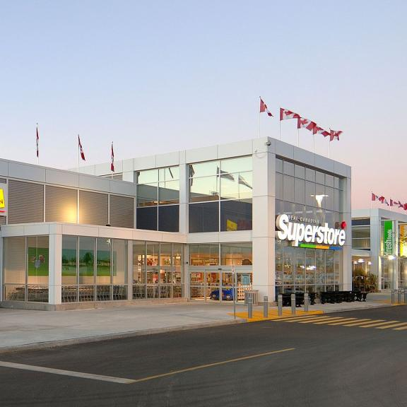

Background
Superstore has been established since 1979. Superstore is the largest supermarket in the United States, they sell items from office supplies such as paper clips to furniture items.
https://www.realcanadiansuperstore.ca/
Superstore Dataset | Kaggle

Slide 3

Problem Definition
Because it has been established for a long time, there are many branch stores scattered in various countries, the number of customers is increasing, which allows the warehouse to be out of stock.
Using sales reports from 2014 to 2017 as research data to predict shipping time, when the goods ordered by customers will be delivered by the seller.

Slide 4
Data Preprocessing
Data Understanding
Data Cleaning
Scalling Data
Data Handling
Label Encode

Slide 5

Data Cleaning
Duplicated Rows
Missing Values
0
0

Slide 6
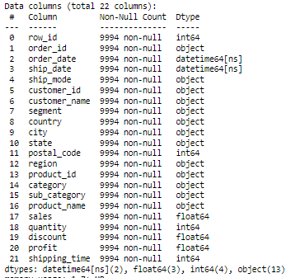
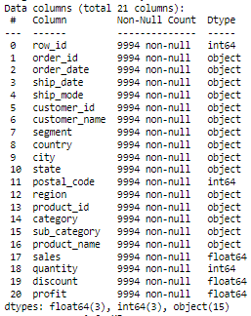


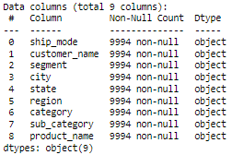
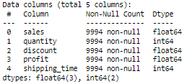
Data Handling

Slide 7
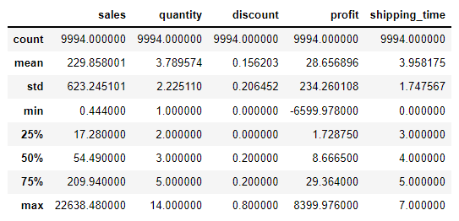
Data Understanding
Observation :
Sales : With minimum value 0.4, maksmimum value 22,638 and mean 230. It means there are very a big difference.
Quantity in table showing average buys ~3 items for each order
Mean of Discount is 15%
With average of Profit earned 29 dollar for each order
Shipping time just 0 – 7 days

Slide 8
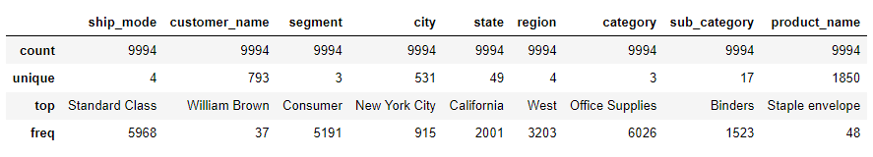
Data Understanding
Observation:
All column has a 9994 rows
Ship_mode have a 4 shipping type with 5.968 customers used a Standard Class shipping
Customer_name have a 793 name, William Brown is who often shop with 37x freq
in a Segment that have a 3 unique type customer
With 531 City, and 49 State in 4 Region different
Product_id is label of each item
Have a 3 Category with the most of sold is Office Supplies
Have a 17 Sub_Category and the most of sold is Binder with 1.523x freq
In Product_name have a 1.850 items

Slide 9
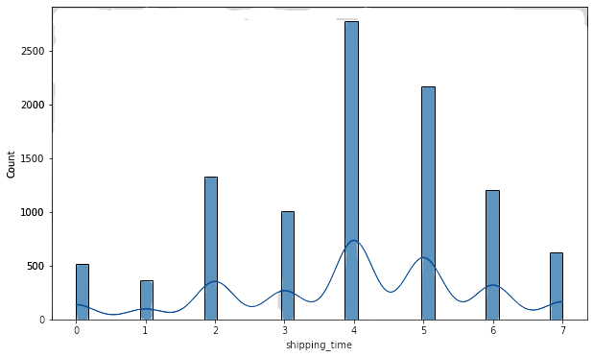
Explanatory Data Analysis
Most shipping times on the 4th day

Slide 10
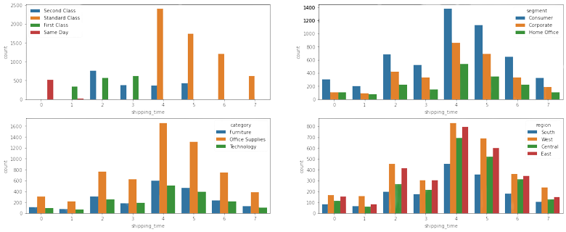
Explanatory Data Analysis
Shipping time for Standar class around 4-6 day
Segment Consumer dominate on day 4
Office supplies is mostly sold in all segments
West Region orders more goods and used a Standar class ship mode

Slide 11
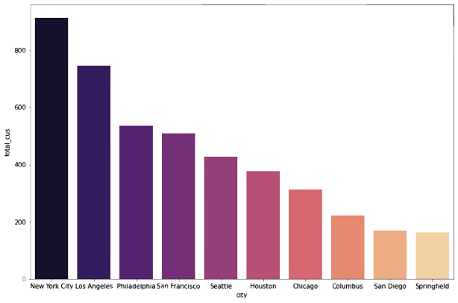
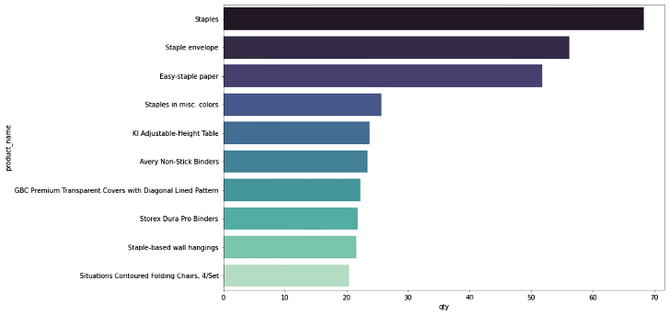
Explanatory Data Analysis
New York City is the most order of goods
Staples are the most of sold

Slide 12
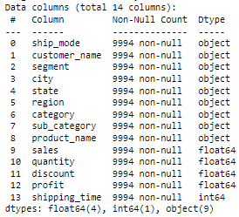
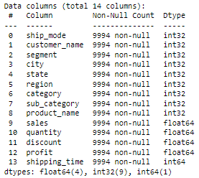
Label Encode
Label encode on categorical columns

Slide 13
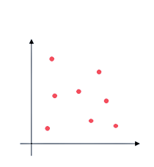
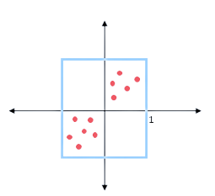
Scalling Data
Actual data
After Normalization

Slide 14

Split Data
Dataset
target
shipping_time
feature
ship_mode
customer_name
segment
city
state
region
category
sub_category
product_name
sales
quantity
discount
profit

Slide 15

Modelling
1
4
5
6
3
2
Kneighbors Regressor
Decision Tree Regressor
Random Forest Regressor
Ada Boost Regressor
Gradient Boosting Regressor
XGBoosting Regressor

Slide 16
Conclusion
MODEL |  | Train Score | Test Score | R Squared | RMSE | MAE
1. | KNN | 0.701244 | 0.407641 | 40.764102 | 0.604310 | 0.580173
2. | Decision Tree | 1.000000 | 0.470545 | 47.054487 | 0.483333 | 0.518563
3. | Random Forest | 0.961155 | 0.716753 | 71.675315 | 0.428220 | 0.277420
4. | Ada Boost | 0.682103 | 0.671296 | 67.129640 | 0.468312 | 0.321941
5. | Gradient Boosting | 0.743826 | 0.688396 | 68.839606 | 0.456007 | 0.305194
6. | XGBoosting | 0.906239 | 0.704719 | 70.471915 | 0.436571 | 0.289206

Slide 17
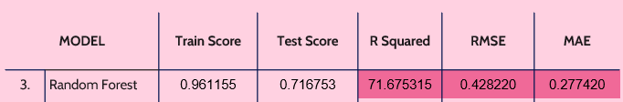
Potential Impact
If using Random Forest Regressor
Simulation :
On average 1 transaction per customer varies on the 4 – 5th day, if there are 100 transactions ordering goods in a day.
The model is able to predict how time it will take the seller to deliver the good in 72 transactions correctly.
MAE 0.27 means that when predicting the 4th day average in shipping_time there is an error of around 27%
.

Slide 18



Recommendation for Business
Give notification for customer to estimate shipping time before payment
Always provide goods in the warehouse, especially for the most sold of goods
When the goods ordered take a long time to deliver, we can give customer a choice for other goods in the same sub category.

Slide 19
THANKS!

